Slide 1
Gravity and Orbits

Slide 2
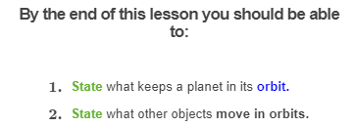
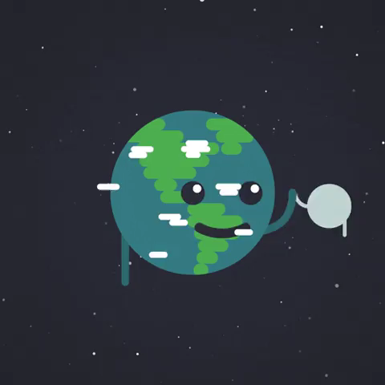

Slide 3
There are many different things in the universe - stars, planets, comets, galaxies and more - but why do they move like they do?
The answer is gravity!
First we will look at what gravity is and how it works. Then we will learn about orbits - the paths that planets like the Earth move in.

Slide 4
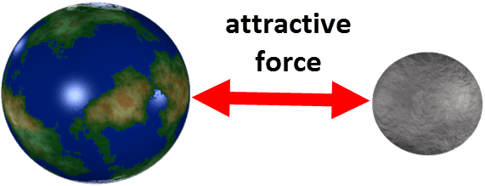
Everything that has a mass has a force field that attracts other masses.
This is known as a gravitational force field and the attractive force is called gravity.
Gravity attempts to pull masses together.

Slide 5
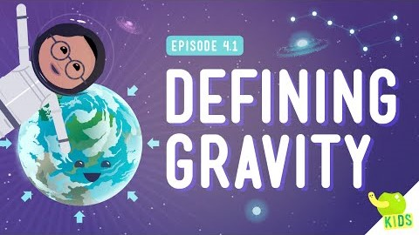

Slide 6
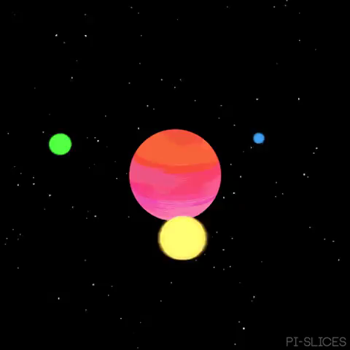
The strength of the gravitational force between two objects depends on two factors.
The mass of an object and the distance between two objects.
Gravity is a force caused by mass: the bigger the mass, the stronger its gravitational field and the more it attracts other objects nearby.

Slide 7
Gravity is only noticeable when objects are really large like a planet, moon or stars.
Everything has a gravitational field, but small things (like you) only have a very weak one.
Gravity is the reason why we don't float off into outer space!

Slide 8
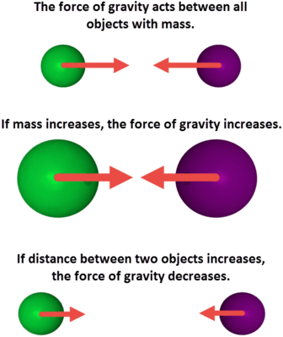
As the distance between objects increases, the gravitational field gets weaker.
The further you move away from Earth, the weaker the gravitational field.

Slide 9
An orbit is a path.
It's the way something goes around an object in space.
The moon goes in orbit around Earth. You're in orbit right now! That's because Earth is following an orbit all the way around the sun.

Slide 10
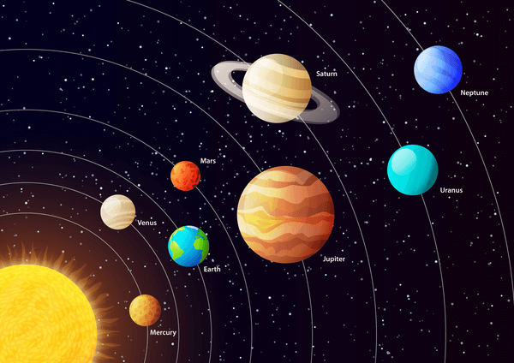

Slide 11
An object in orbit is called a satellite.
A satellite can be natural, like the moon. It can be human-made, like the International Space Station. Earth is a natural satellite of the Sun.
Planets, comets, asteroids (we will learn more about these in the next two lessons) and other objects orbit the Sun. Many planets also have moons. These moons go in orbits around their planets.

Slide 12
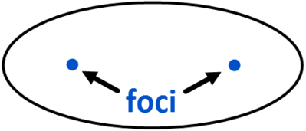
What shape is an orbit?
Orbits are always elliptical. An ellipse is a shape like a flattened circle, but it has special properties.
It has two focal points, or foci. The further apart these two foci are, the more flattened the ellipse is. If the two foci were on top of each other, the shape would be a perfect circle.

Slide 13
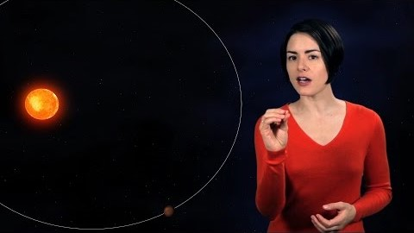

Slide 14
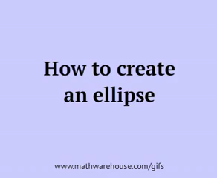
Why don't you have a go at drawing an ellipse?
All you need is two pins, a piece of string, and a pencil!

Slide 15
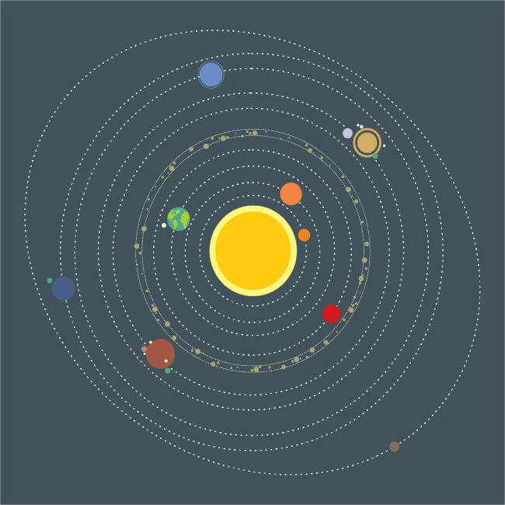
An ellipse can be very long and thin, or it can be quite round - almost like a circle.
Earth's orbit is almost circular. Pluto has a much less circular orbit than any of the planets in our Solar System.

Slide 16
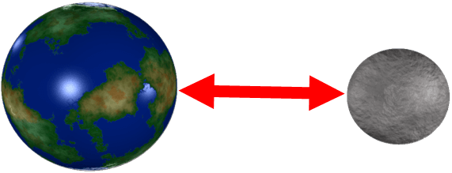
How do objects stay in orbit?
A moving object will continue moving unless something pushes or pulls on it. This statement is called Newton's First Law of Motion.
Without gravity, a satellite would fly off into space. With gravity, a satellite is constantly pulled back toward Earth. This tug-of-war keeps the satellite in orbit.
The red arrow below indicates the gravitational force between Earth and the Moon:

